Slide 1

DIGIVERZ PROJECT SALES FORCASTING
Using Angular JS, Flask and Machine Learning
DONE BY
Vigneshwar B

Slide 2
MODULES
CLIENT SIDE
SERVER SIDE
MONGO DB
MACHINE LEARNING
ERROR VALUATION
POWER BI

Slide 3
CLIENT SIDE
Components
Home
Login
Predict dataset
Saved predictions

Slide 4
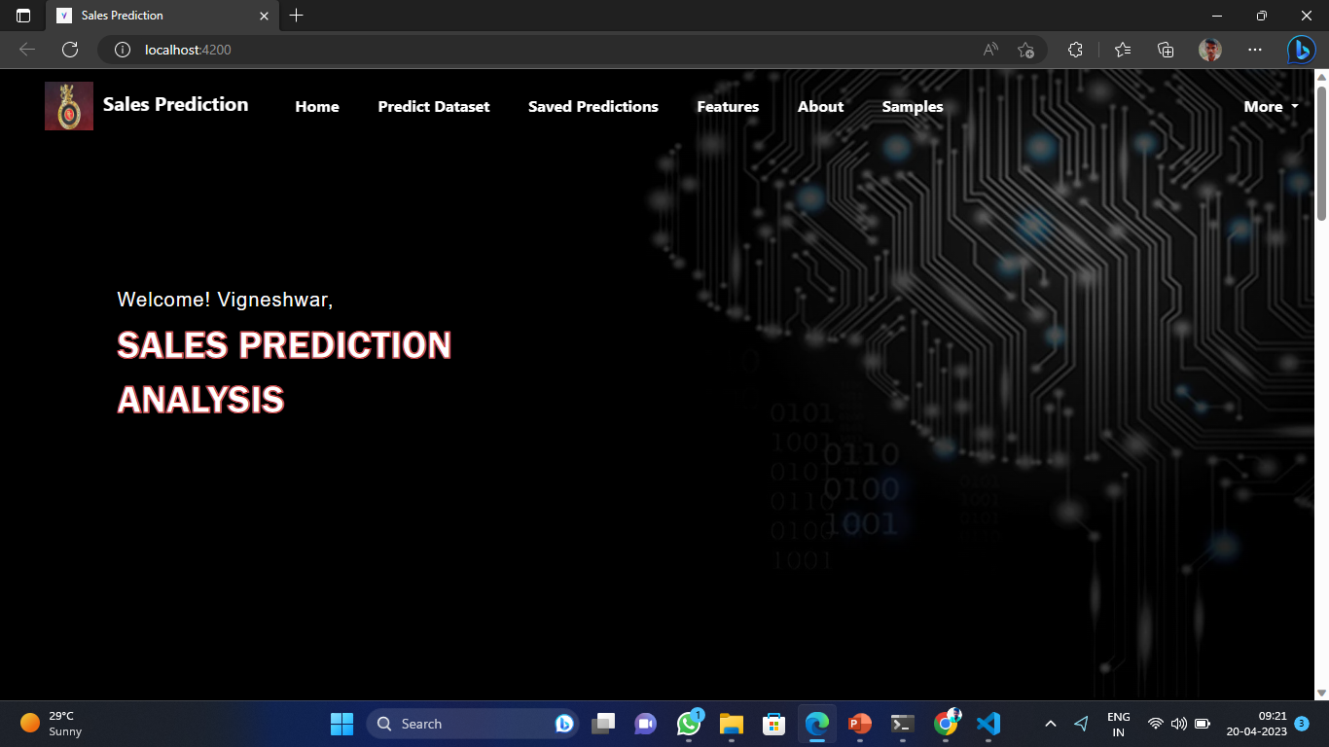
CLIENT SIDE
HOME

Slide 5
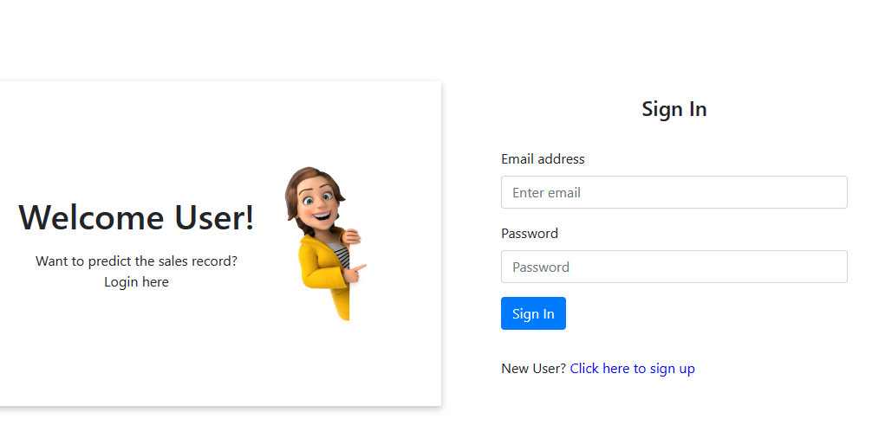
CLIENT SIDE
LOGIN

Slide 6
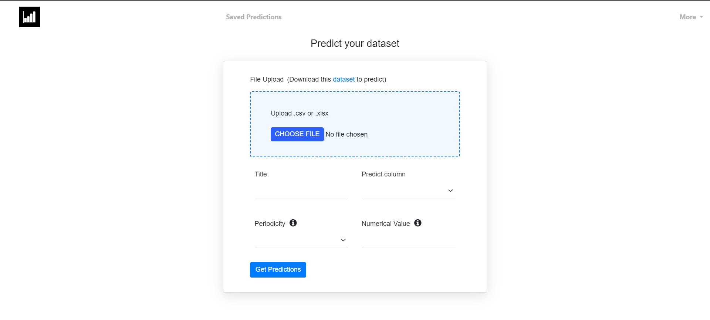
CLIENT SIDE
PREDICT DATASET

Slide 7
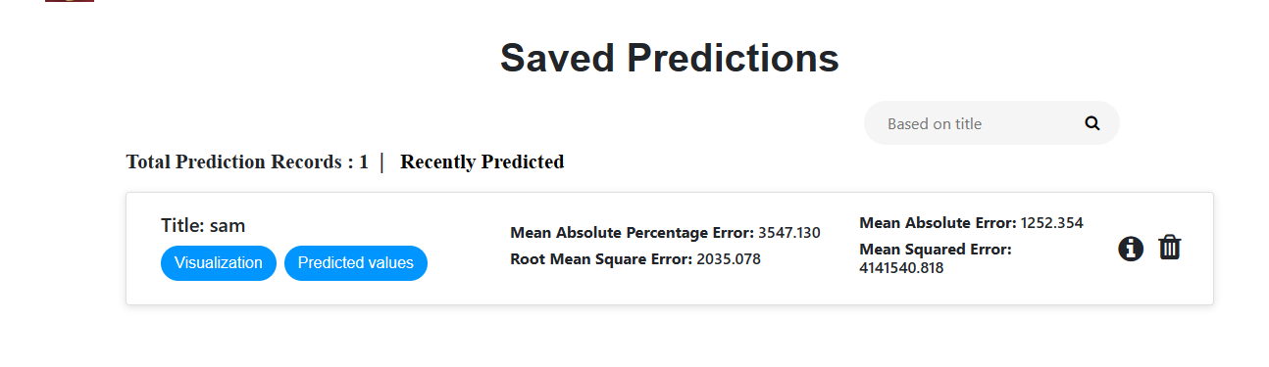
CLIENT SIDE
SAVED PREDICTIONS

Slide 8
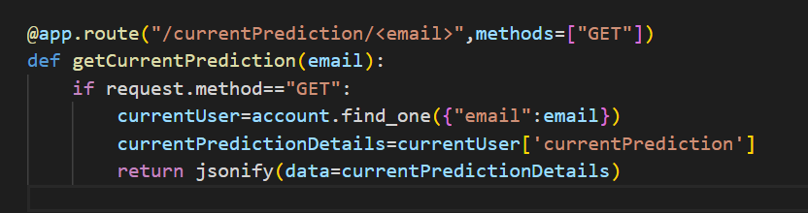
SERVER SIDE
GET REQUEST

Slide 9
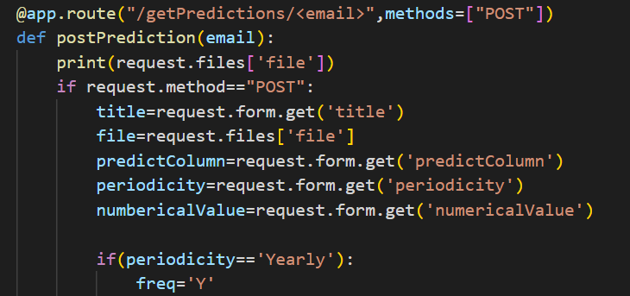
SERVER SIDE
POST RESPONSE

Slide 10
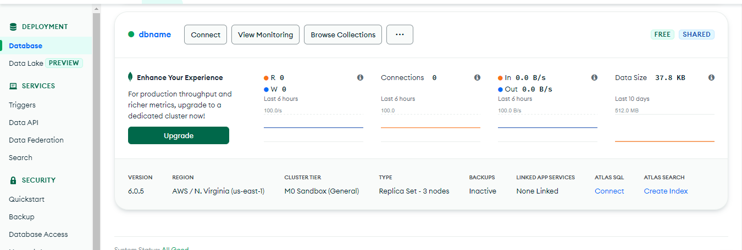
MONGO DB

Slide 11
MACHINE LEARNING
In this project, the machine learning part is done in the prediction function of the server-side scripting itself.
Using ARIMA model, sales predictions are done
What is ARIMA Model?
ARIMA in Time Series Analysis
An autoregressive integrated moving average – ARIMA model is a generalization of a simple autoregressive moving average . This model is used to forecast or predict future points in the time-series data.

Slide 12
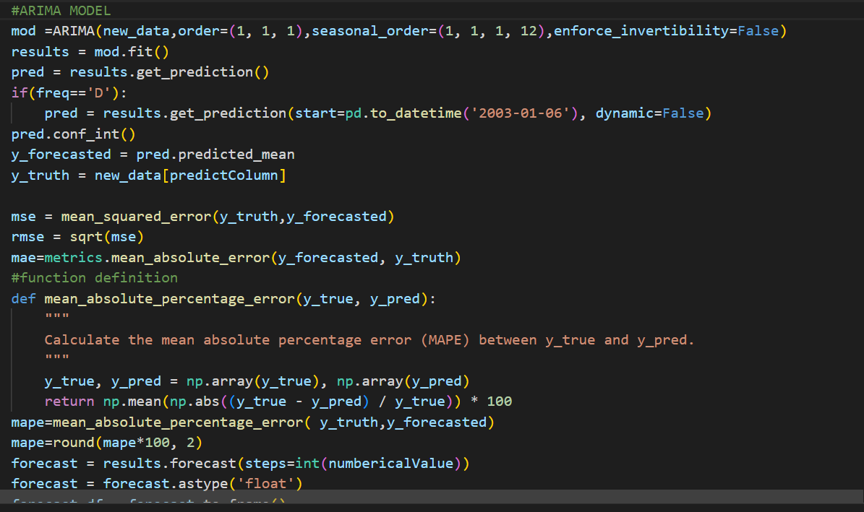
MACHINE LEARNING

Slide 13
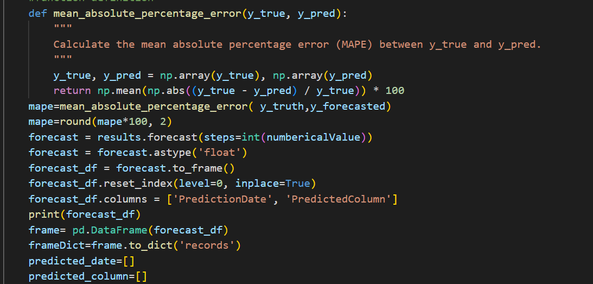
ERROR VALUATION

Slide 14
POWER BI
Microsoft Power BI is used to find insights within an organization's data.
Power BI can help connect disparate data sets, transform and clean the data into a data model and create charts or graphs to provide visuals of the data.
All of this can be shared with other Power BI users within the organization.

Slide 15
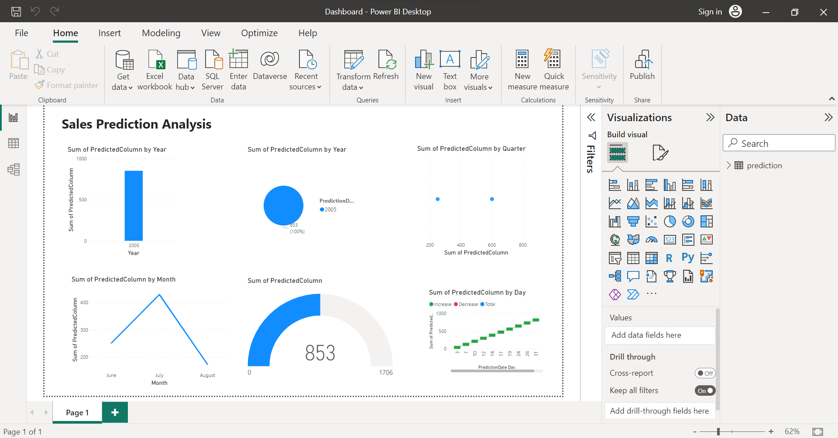
POWER BI

Slide 16
THANK YOU

